Slide 1

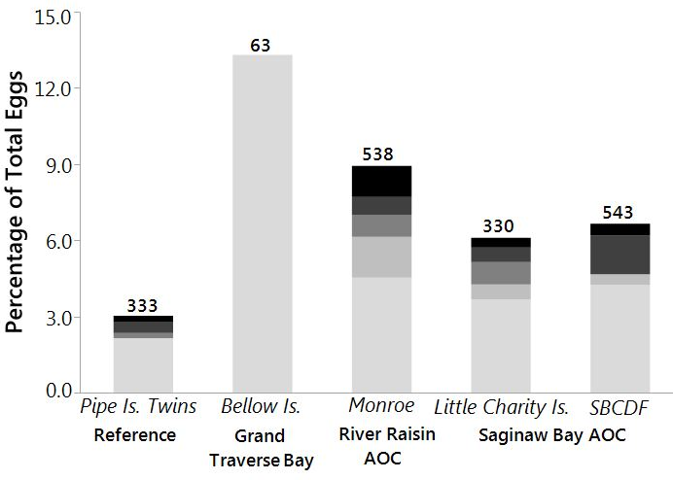
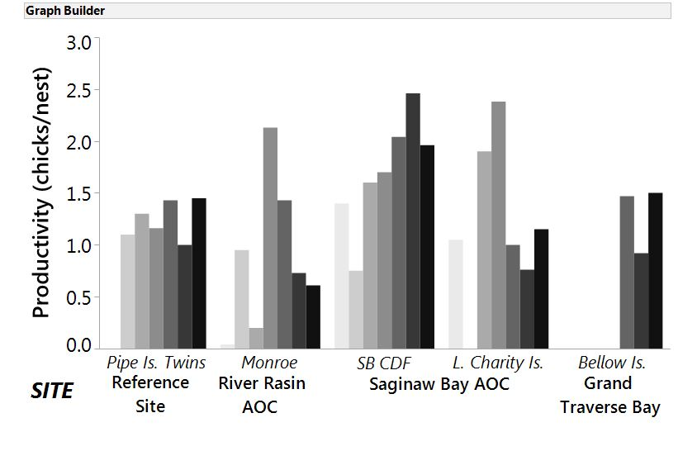
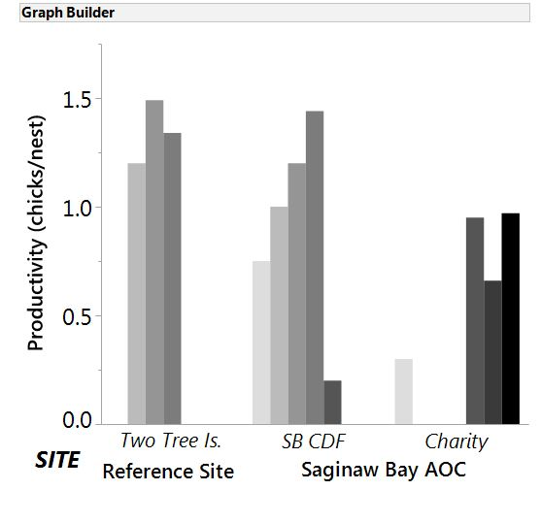
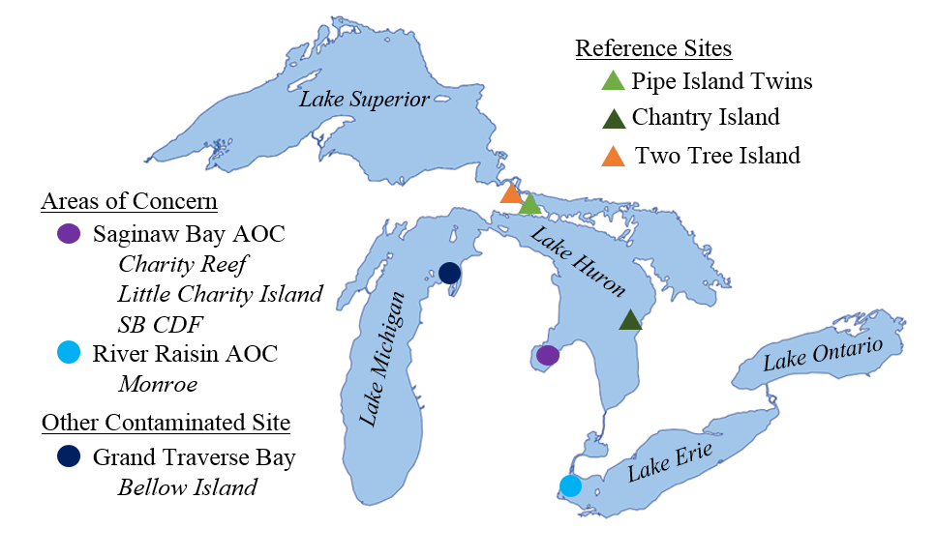

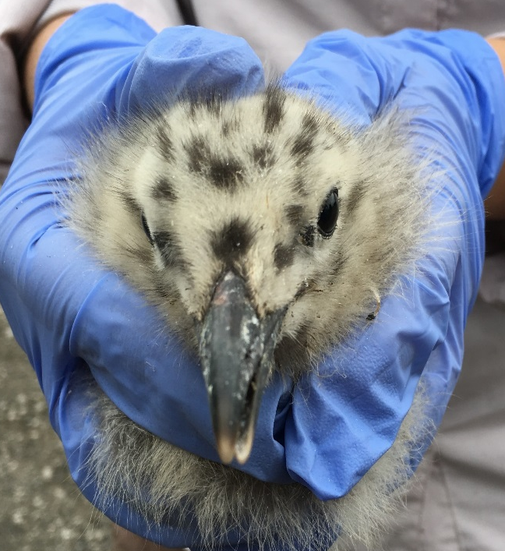
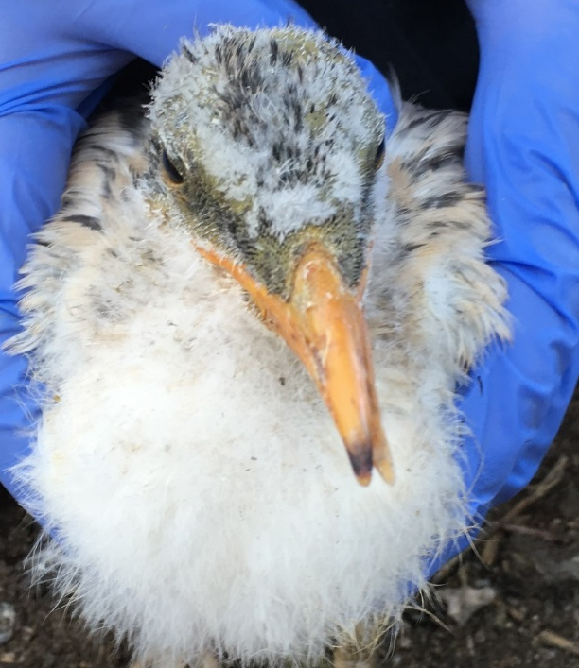


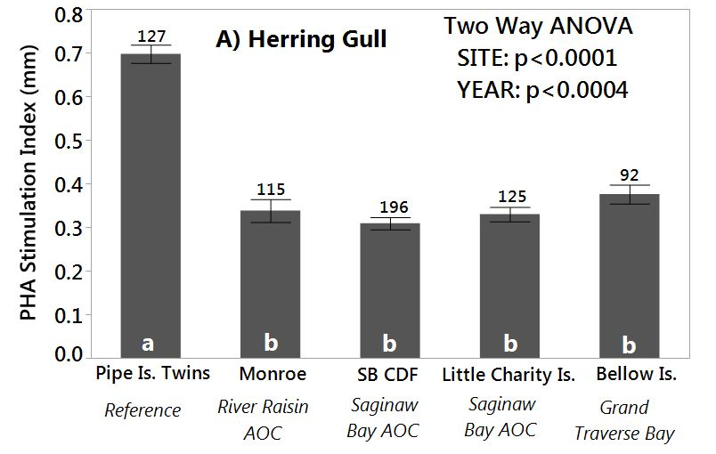
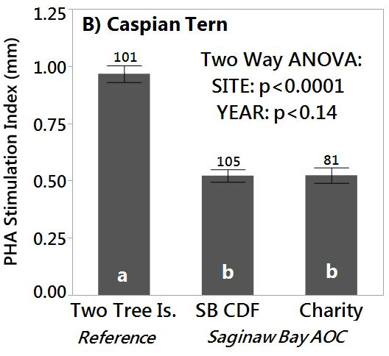
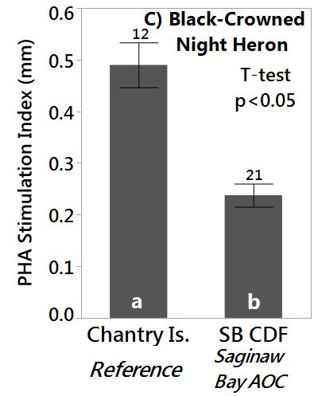
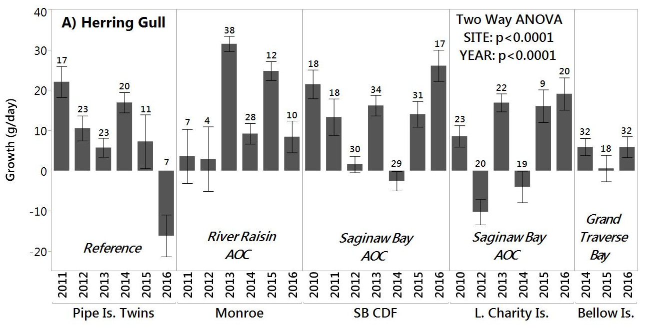
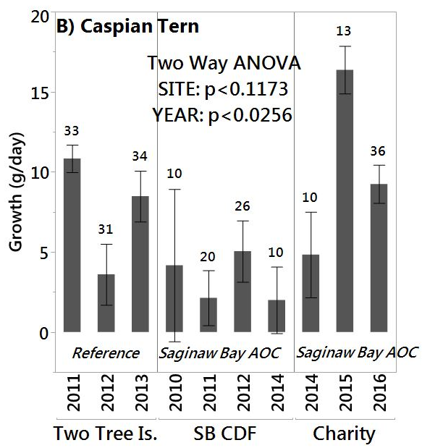
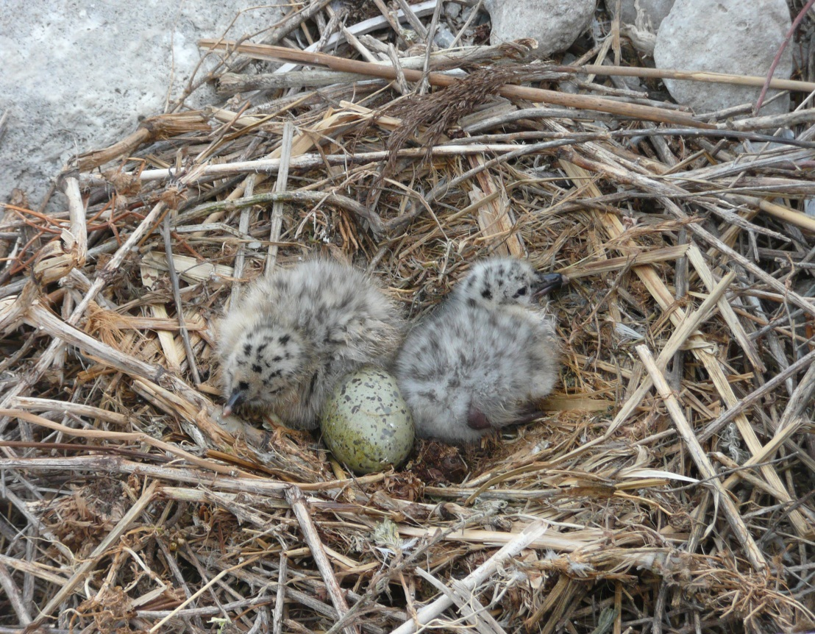
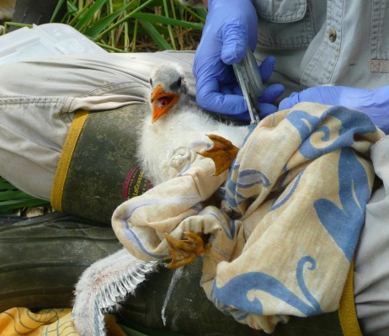
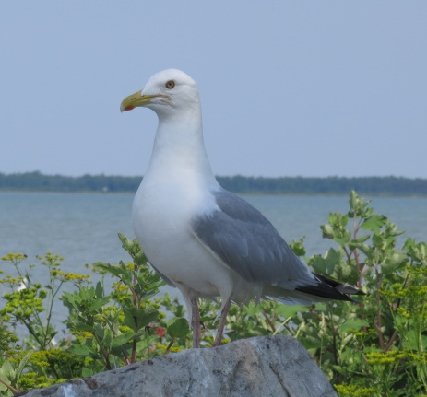
Great Lakes Restoration Initiative: Reassessment of Wildlife Reproduction and Health Impairments in the Saginaw Bay and River Raisin Areas of Concern and Grand Traverse Bay
K. A. Grasman, D. Bouma, S. Hughes, R. Warners, Department of Biology, Calvin College, Grand Rapids, MI
M. Annis, J. Moore, L. Williams, U.S. Fish and Wildlife Service, Region 3, East Lansing, MI
Introduction
A) Herring Gull
B) Caspian Tern
The Great Lakes have been polluted with organochlorines such as polychlorinated biphenyls (PCBs) and chlorinated dioxins since the late 1950s. Increased rates of mortality and deformities in waterbirds that inhabit the Great Lakes ecosystems were first noticed in the early 1970’s (Grasman et al, 1998). Since then, PCBs exhibited a strong correlation to a serious chick edema disease in chickens and a similar illness called GLEMEDS (Great Lakes Embryo Mortality, Edema, and Deformities Syndrome) in fish-eating birds (Gilbertson et al, 1991). Dichlorodiphenyltrichlorethane (DDT), an organochlorine, and its breakdown product dichlorodiphenyldichlorethylene (DDE) have been shown to induce eggshell thinning in many species of Great Lakes waterbirds (Grasman et al, 1998). In previous studies, areas with higher concentrations of organochlorines had birds with suppressed T cell-mediated immune responses compared to birds at reference sites (Grasman et al., 1996).
The Great Lakes Water Quality Agreement was created in 1972 by the United States and Canada in order to effectively treat and assess the health of the Great Lakes. Since then, the agreement has expanded to include 14 Beneficial Use Impairments, or specific guidelines, to designate and maintain Areas of Concern (AOCs). (Environment Canada, 2013) AOCs are distinguished by severe degradation and/or high contamination of its ecosystem. As part of the US Fish and Wildlife Service’s efforts under the broader Great Lakes Restoration Initiative, the current study monitors the river Raisin AOC and Saginaw Bay AOC. In particular, the study focuses on two Beneficial Use Impairments: 1.) Degradation of fish and wildlife populations and 2.) Bird/animal deformities or reproduction problems. In 2014 an unusual combination of contaminants - a high level of dioxin toxic equivalents (TEQs), relatively low concentration of PCBs, and high level of DDE -was detected at Bellow Island in Grand Traverse Bay and resulted in its addition to the study.
This study reexamines the reproduction, growth, and immunological responses of colonial waterbirds (herring gulls, Caspian Terns, and black-crowned night herons) in the Great Lakes to evaluate the effect of organochlorides. Embryonic mortality, deformities, reproductive success, growth, T cell-mediated immune function (phytohemagglutanin (PHA) skin test), and antibody response (sheep red blood cell (SRBC) test) are all techniques used in this study to observe and analyze the health of the birds and in turn, the health of the ecosystems. The PHA skin test and the SRBC test are well known measures of immune function in avian test subjects (Grasman, 2002). The ecological relevance of these two tests has been demonstrated by studies showing that wild songbirds with higher immune responses have higher rates of survival and dispersal into new areas (Moeller and Saino, 2004; Moeller and Cassey, 2004).
Figure 2. Embryonic nonviability in herring gulls at the Saginaw Bay and River Raisin AOCs and Grand Traverse Bay during 2010, 2012-16. Numbers on bars are egg totals. “Undetermined” categorizes infertile or failed eggs that were difficult to distinguish due to addling.
A
B
R.
Figure 1. Colonial water-bird colony locations studied in Great Lakes AOCs, other polluted sites, and reference sites for this assessment of health and reproduction in fish-eating birds during 2010-16.
Figure 3. Crossed-billed Herring gull chick (3 weeks) found at the Monroe colony during 2016 (A) and a cross-billed Caspian tern chick (4 weeks) found at Little Charity Island during 2016 (B).
Figure 4. Reproductive productivity (number of 3 week old chicks surviving per nest in an enclosure) at AOCs, Grand Traverse Bay, and reference sites in 2010-16. For herring gulls, productivity of 0.75 chicks/nest or greater is necessary to maintain a stable population (Kadlec and Drury 1968).
Figure 5. Mean phytohemagglutinin (PHA) stimulation index, a measure of the T cell-mediated immunity in pre-fledging, fish-eating birds at AOCs, Grand Traverse Bay, and reference sites in 2010-16. Bars sharing the same letter were not statistically different by Tukey’s test (p<0.05). Numbers on bars indicate sample sizes. Error bars indicate the standard error.
Figure 6. Mean growth in body mass between 3 and 4 weeks of age in pre-fledgling fish-eating birds at Great Lakes AOCs, Grand Traverse Bay, and reference sites in 2010-16. Normal mean growth rates are 14-20 g/day for herring gulls and 4-18 g/day for Caspian terns (Grasman et al. 1996). Numbers on bars are sample sizes. Error bars indicate standard error.
Embryonic Nonviability
Herring Gull nests containing one to two eggs were marked during laying. Embryonic viability was assessed during mid incubation (21 days) using an Avitronics Digital Egg Monitor (Cornwall England) which measures the embryo's heart rate and movement. Nonviable eggs were opened and inspected to identify stage of development, deformities or infertility.
Growth and Reproductive Success
Body mass and size measurements are taken at 3 and 4 weeks of age in order to evaluate the average growth (or degradation) rate of chicks in the colonies.
Chick productivity within the enclosures is measured by counting the number of chicks alive at three weeks divided by the number of nests enclosed.
Immune Function
T-cell mediated immune test: The initial wing web thickness of three week gulls and terns and two week herons is measured with pressure sensitive calipers. The chicks are then injected with a lymphocyte activator, Phytohemagglutinin (PHA) in phosphate buffered saline (PBS), in one wing web and a placebo of PBS in the other. 24 hours after the initial injection, the wing web thickness is measured a second time to quantify the T cell-mediated response. The PHA stimulation index is a measure of the difference between the change in the PHA wing web and the change in the PBS (placebo) wing web thickness (Grasman et al. 1996).
Antibody response test: A sheep red blood cell (SRBC) suspension is injected into the wing of three week old chicks to trigger antibody production. The hemagglutination assay is done using plasma from four week old chicks by serial dilutions with addition of SRBCs. Total antibody response titer value is determined as the highest dilution where agglutination formed between the antigen and antibody. IgG antibody response was assessed by denaturing IgM antibodies with 2-mercaptoethanol prior to the addition of SRBCs (Grasman et al. 1996).
Results and Discussion
Conclusions
Materials and Methods
Embryonic Nonviability and Deformities
Embryonic nonviability rates in late incubation herring gull eggs were elevated at Monroe in the River Raisin AOC (multi-year rate of 8.9%) and both sites in the Saginaw Bay AOC (SB CDF: 6.4% and Little Charity Island: 6.1%) as compared to the reference site at the Pipe Island Twins (3.0%) (Fig. 2). Other reference sites in studies by Craig Herbert of Environment Canada showed a nonviability rate of less than 2% (personal communication). Infertility was the primary contributor to nonviability at the Pipe Island Twins reference site and substantially affected nonviability at all AOC colonies. The River Raisin and Saginaw Bay AOCs had more failure during development than other sites. Crossed-bill deformities were found in three herring gull chicks at the River Raisin AOC during 2012 (7mm offset of the upper and lower bill), 2013(4mm offset) , and 2016 (__mm offset; fig. 3a) and a Caspian tern chick at the Saginaw bay AOC (__mm offset; fig. 3b). Embryonic nonviability and deformities such as crossed bills are characteristic of GLEMEDS and are associated with exposure to PCBs and dioxins (Gilbertson et al. 1991, Grasman et al., 1998).
Reproductive Success
While chick productivity was consistently high at the reference colonies, reproductive success was substantially lower at some AOC colonies in some years. Stable herring gull populations usually produce at least 0.75 chicks/nest (Kadlec & Drury 1968). The reference site on Pipe Island Twins produced 1-1.45 chicks/nest between 2011 and 2016. In 2010-16, gulls in the Saginaw Bay AOC were stable (0.75- 2.46 chicks/nest), but in one of seven years at SB CDF and two of six years at Little Charity Island, reproduction was lower than the reference colony. Productivity in the Monroe colony fluctuated between the years, with low productivity in three of seven years and complete failure in 2010. Gulls in Grand Traverse Bay (0.92-1.5 chicks/nest) had comparable productivity to the reference site (Fig. 4A).
Caspian terns at the Saginaw Bay AOC had low productivity in some years. At reference sites, terns had consistently strong reproductive success (1.2-1.49 chicks/nest). The SB CDF showed low productivity in 2014 (0.2 chicks/nest) and complete failure in 2015 and in 2016 a colony was found at a different location too late to add to the study. In 2010 and 2015, the Charity site had low productivity (0.3 and 0.66 chicks/nest) (Fig. 4B).
Growth
In some years, young birds at both AOCs and Bellow Island had poor rates of growth. Gulls at Monroe had lower growth than the reference sites in four out of six years and Little Charity
Island had lower growth than the reference sites in three out of five years. Additionally, the
overall mean growth for Little Charity Island was significantly lower than Pipe Island Twins reference site (Tukey p<0.05). However, in 2013, 2015 and 2016 the mean growth for the reference site was lower than all sites except Bellow Island. However, this is most likely due to the fact that food supply at the reference site is lower than at AOCs. Bellow Island had lower growth than the reference site for all years studied. The normal mean growth rate for herring gulls is 14-20 g/day (Grasman et al., 1996) which was achieved four times at the CDF and twice at Pipe Island Twins, Monroe, and three times at Little Charity Island (Fig. 5A).
The mean growth rate for Caspian terns in this study was lower than the normal mean growth rate of 4.0-18.0 g/day (Grasman et al., 1996). At the reference site, growth ranged from 3.6-10.8 g/day. Reference site growth rates might have been reduced by a less abundant food supply. However, terns in the highly productive Saginaw Bay ecosystem averaged only 2.0-5.0 g/day for mean growth rate in 2010-2014 (Fig. 5B). In 2016 terns averaged a healthy 9.25g/day and a large sample size was collected. In 2015, the high growth rate was likely caused by the young age of the chicks (2-3 weeks) on Little Charity Is.
T Cell-Mediated Immunity
Herring gulls and Caspian terns had a lower T cell-mediated immune response at all AOC sites as well as at Grand Traverse Bay compared to the reference sites at Pipe Island Twins and Two Tree Island (Two-way ANOVA site: p<0.0001) (Fig. 6A, B). The mean PHA skin response of gulls was 52-55% lower at AOCs compared to the Pipe Island Twins. Gulls in Grand Traverse Bay had a 46% lower mean PHA skin response than the reference site at Pipe Island Twins (Tukey p<0.05). Caspian terns at AOCs had a 46% lower response as compared to Two Tree Island. Black-crowned night herons on the CDF showed a 39% lower T cell response compared to herons at the Chantry Island reference site (Fig. 6C).
Antibody Titer of Plasma Samples
Herring gulls at the AOC sites and Grand Traverse Bay had significantly lower total antibody responses and lower IgG responses than herring gulls at the Pipe Island Twins reference site (Two-way ANOVA site: p<0.0001, Tukey p<0.05). At AOCs mean titer values for total antibodies (4.3-4.9) and IgG responses (2.1-3.0) were significantly lower than values for the reference site (Total: 5.6, IgG: 4.1). For Caspian Terns, total and IgG responses differed by year, but not by site (Two-way ANOVA Total by year: p< 0.0001, site: p< 0.09, IgG by year: p< 0.0001, site: p< 0.066) (Fig. 7).
Herring gulls, Caspian terns, and black-crowned night herons in the Saginaw Bay AOC exhibited adverse health effects, including decreased immune responses and (or) decreased productivity, which were consistent with past studies:
Embryonic nonviability in gulls was higher at the AOC
Tern populations had lower productivity at the AOC in some years
Chick growth was significantly lower at Little Charity Island and SB CDF for gulls and terns
Suppressed T cell-mediated immunity in herring gulls, Caspian terns, and black-crowned night herons in all years
Suppressed total antibody and IgG responses in herring gulls in all years
Herring gulls at the River Raisin AOC showed impairments in immune responses and reproductive success, consistent with past studies
Higher than normal embryonic nonviability and deformities
Complete reproductive failure one year, and low chick productivity in two more years
Decreased growth rates for chicks in three out of five years
Suppressed T cell-mediated immune response in all years
Suppressed total antibody and IgG responses in all years
Herring gulls at Grand Traverse Bay, a site with high concentrations of TEQs and DDE, showed impairments in immune responses and growth
Low growth rate between three and four weeks of age
Suppressed T cell-mediated immune response
Suppressed total antibody response
Study Sites (See Fig. 1):
Reference:
  Pipe Island Twins: gulls 2011-16
  Two Tree Island: terns 2011-13
  Chantry Island: herons 2001-2002
River Raisin AOC:
  Monroe: gulls 2010-2016
Grand Traverse Bay:
  Bellow Island: gulls 2014-16
Saginaw Bay AOC:
Saginaw Bay Confined Disposal Facility: gulls 2010-16
  terns 2010-14
  herons 2010
  Little Charity Island: gulls 2010, 2012-16 terns 2016
  Charity Reef: terns 2010, 2014
Acknowledgements
This project was funded by the Great Lakes Restoration Initiative Funding for Area of Concern and Remediation and Restoration of Contaminated Sediments through the U. S. Fish and Wildlife Service, Region 3. Ted Ludwig, Jim Ludwig, Dave Best, and Therese Best provided logistical support in the field while Calvin VanOpstall provided contributed greatly to lab work. Research stipends from Calvin College were provided to Rachel Warners and Sarah Hughes.
References
Environment Canada. 2013. History of the Great Lakes Water Quality Agreement.
Gilbertson, M., T. Kubiak, J. Ludwig, and G. Fox. 1991. Journal of Toxicology and Environmental Health 33:455-520.
Grasman, K.A., G. Fox, P. Scanlon, and J. Ludwig. 1996. Journal of Toxicology and Environmental Health 104:29-842.
Grasman, K.A., P. Scanlon, and G. Fox. 1998. Environmental Monitoring and Assessment 53:117-145.
Kadlec, J.A., and W.H. Drury. 1968. Ecology 49:644-676.
Moller, A. and P. Cassey. 2004. Journal of Animal Ecology 73:1035-1042.
Moller, A. and N. Saino. 2004. Oikos 104:299-304.

